Slide 1

URBAN PLANING AND SMART CITIES

Slide 2






Meet the team
SOUTIK MANDAL
211001001199
ARIJIT PAL
211001001208
BITTU KUMAR SINGH
211001001209
SOUVIK PAUL
221003004001
ANIRDAM
PATHAK
221001011010
Team number-2022102 / JRP No. – JRP2

Slide 3

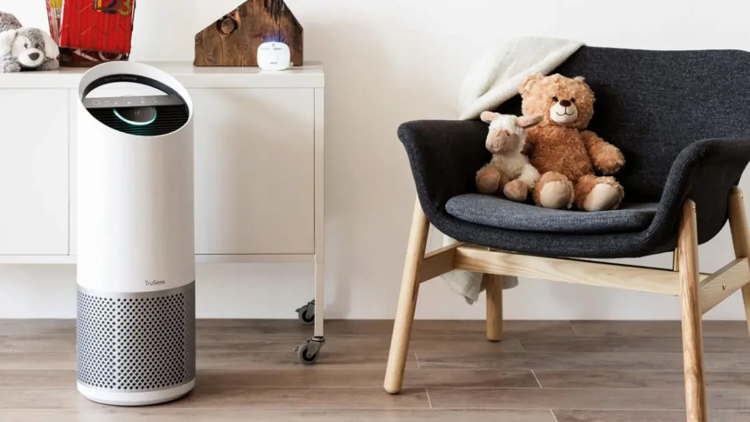
Smart Air Purifier: Revolutionizing Indoor Air Quality

Slide 4

Content
1. Understanding Indoor Air Pollution 2. Smart Air Purifier Technology 3. Market Opportunities and Consumer Trends 4. Brand Positioning and Marketing Strategy

Slide 5

Section 1
Understanding Indoor Air Pollution

Slide 6

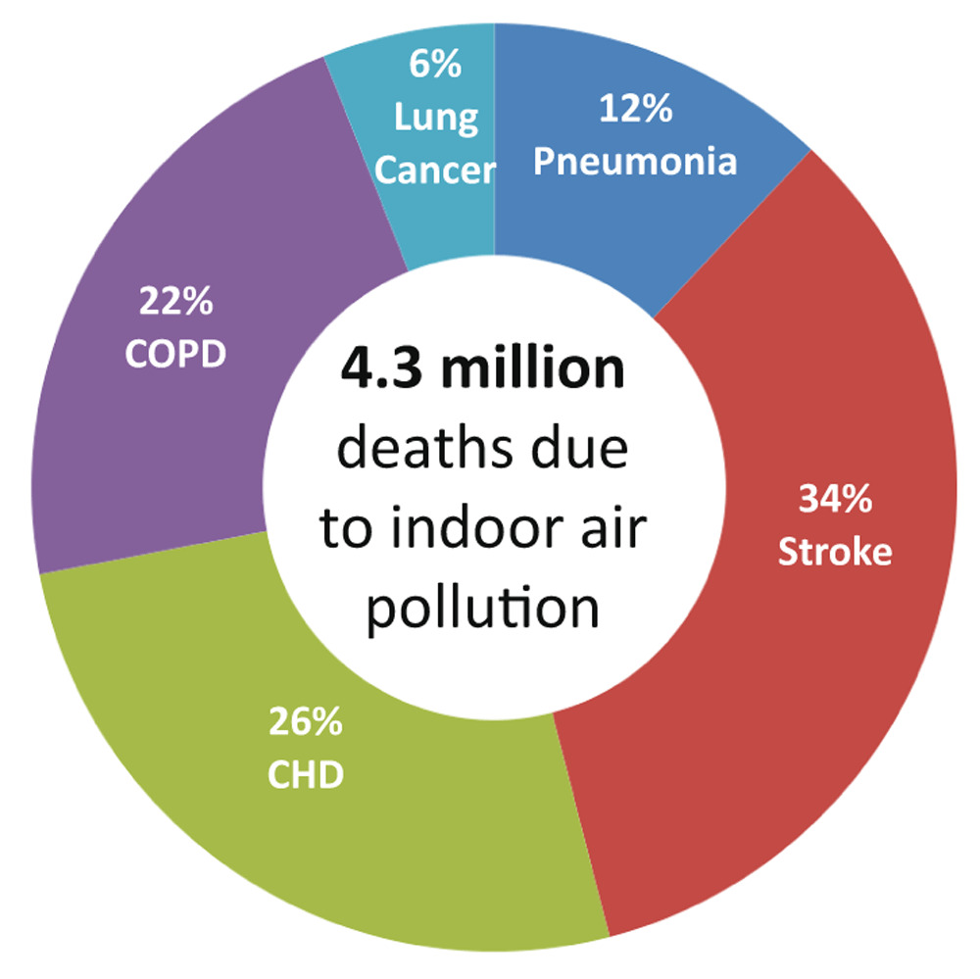
Impact of Indoor Air Pollution
Health Implications:
Poor indoor air quality can lead to respiratory issues, allergies, and other health problems.
Common Pollutants:
Indoor air can contain dust, pet dander, pollen, and volatile organic compounds (VOCs).
Invisible Threat:
Many indoor air pollutants are not visible to the naked eye, making it crucial to address them proactively.

Slide 7

The Need for Smart Air Purifiers
Rising Concerns:
Increased awareness about the health impact of indoor air pollution has led to a growing demand for effective air purification solutions.
Smart Features:
Smart air purifiers offer real-time air quality monitoring, remote control, and integration with smart home systems.
Efficiency and Convenience:
These purifiers provide efficient air cleaning while offering user-friendly features for enhanced convenience.

Slide 8

Case Study: Impact on Health and Productivity
Health Improvement
A case study of an office environment showed a significant decrease in employee sick days after the installation of smart air purifiers.
Enhanced Productivity
Improved air quality led to increased focus, reduced fatigue, and enhanced overall productivity among employees.
Employee Satisfaction
The initiative to improve indoor air quality was well-received, positively impacting employee morale.

Slide 9
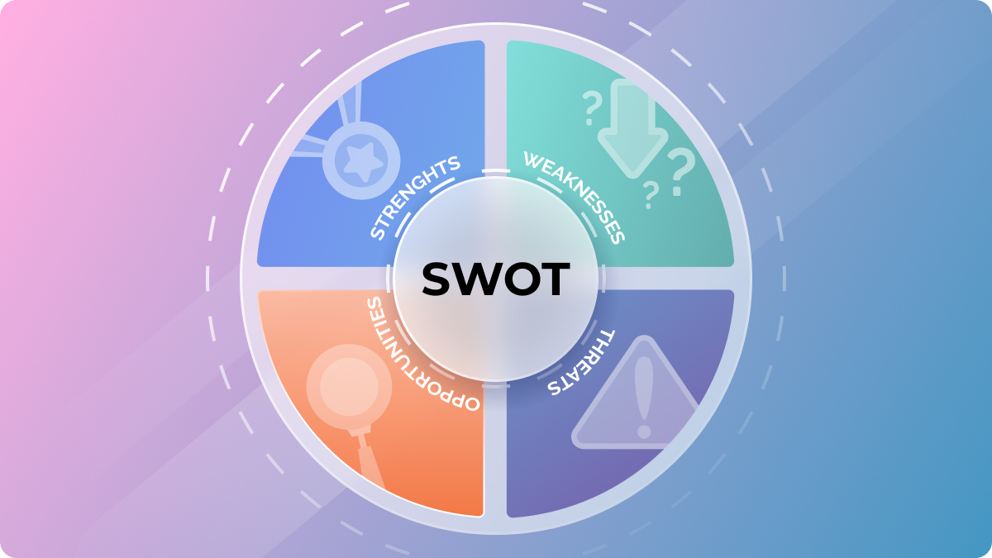
SWOT Analysis
Strength
Smart air purifiers offer real-time air quality monitoring and smart features, providing a competitive edge in the market.
Weakness
High initial investment and the need for regular filter replacements may deter some potential customers.
Opportunity
Growing consumer awareness and the increasing focus on health and wellness present a significant opportunity for market growth.
Threat
Competition from traditional air purifiers and the need to educate consumers about the benefits of smart air purifiers.

Slide 10
Section 2
Smart Air Purifier Technology

Slide 11
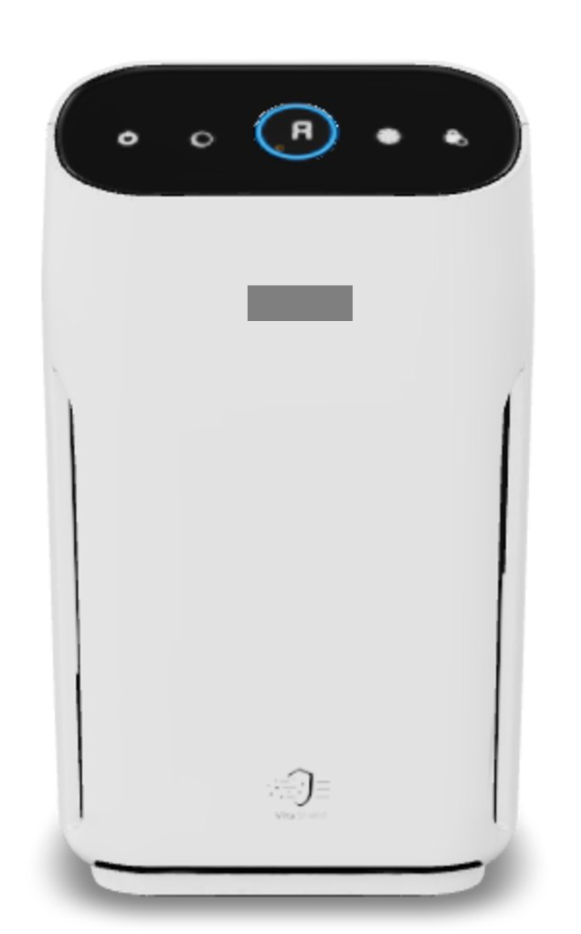
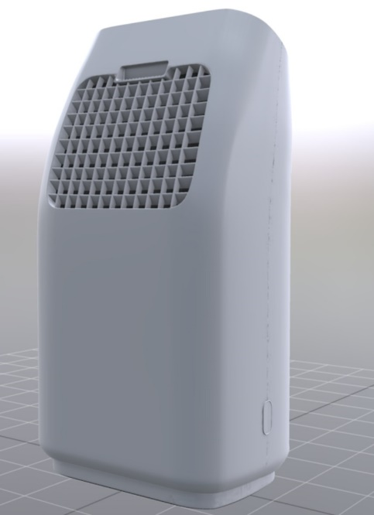
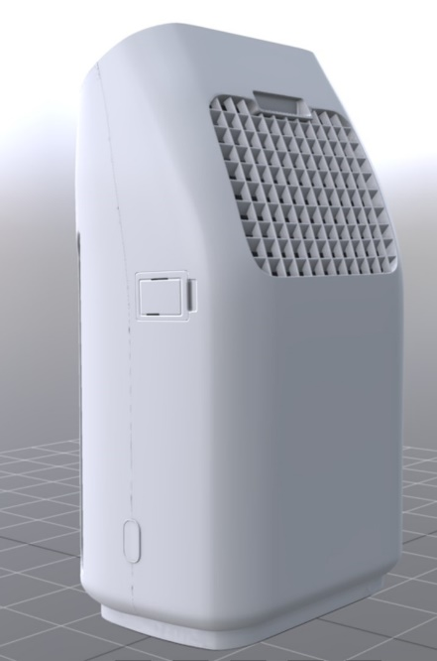
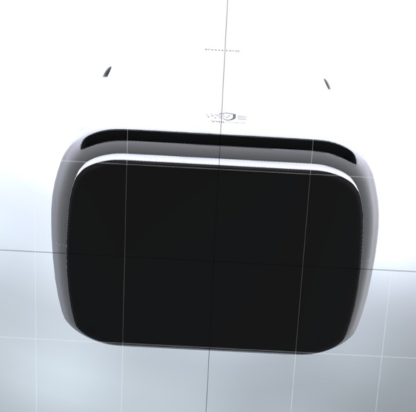
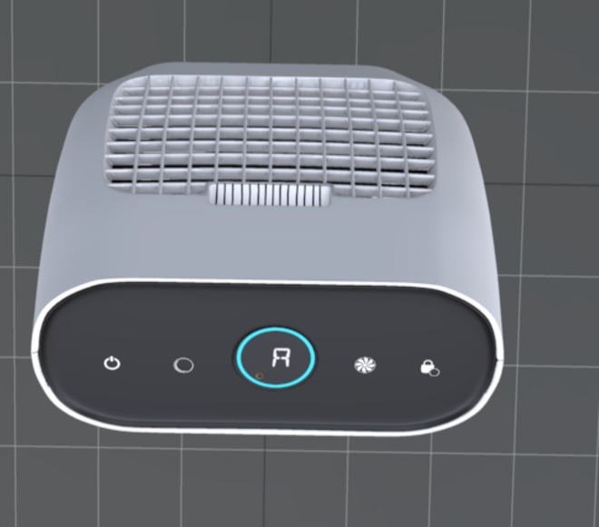
Our Designs

Slide 12
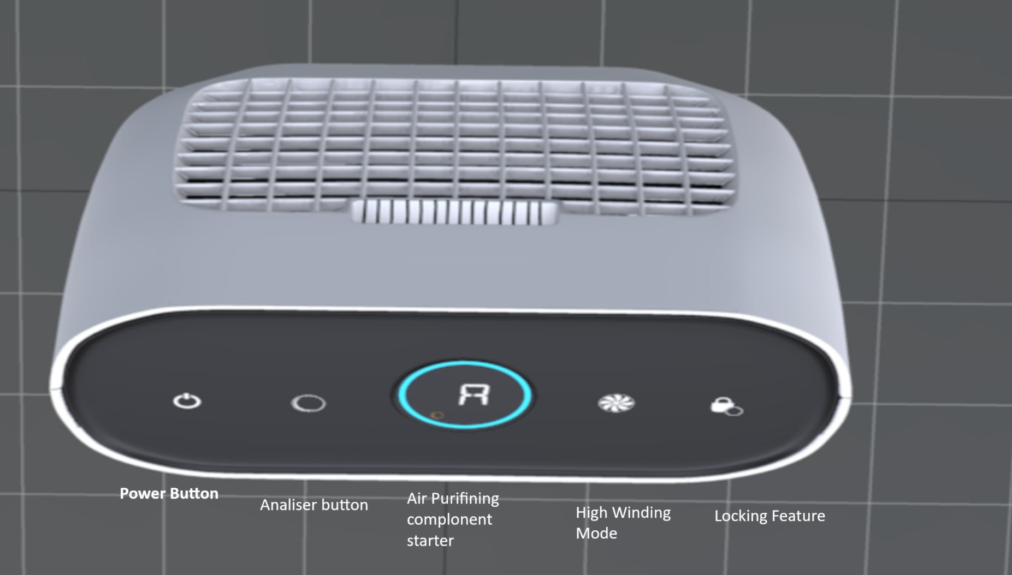
Switch Specification

Slide 13
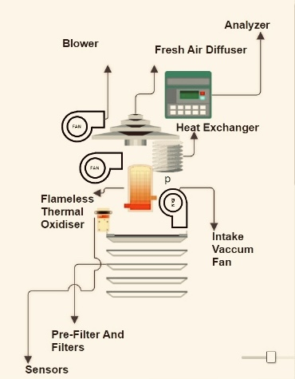
Inner system and main components

Slide 14

Advanced Filtration Systems
HEPA Filtration
High-Efficiency Particulate Air (HEPA) filters effectively capture airborne particles, ensuring cleaner air.
Activated Carbon Filters
These filters adsorb, gases, and VOCs, improving overall air quality.
Pre-Filters
Pre-filters capture larger particles, extending the lifespan of the primary filters and enhancing purification efficiency.

Slide 15

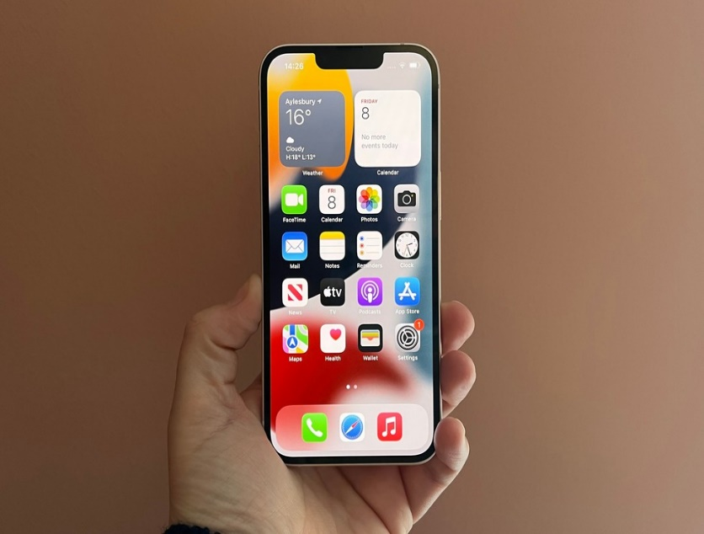

IOT Integration and Connectivity
Real-time Monitoring
Smart air purifiers are equipped with sensors that monitor air quality and provide instant feedback to users.
Mobile App Control
Users can remotely control the purifier, monitor air quality data, and receive filter replacement notifications through dedicated mobile apps.
Voice Control Integration
Integration with voice assistants allows users to control the purifier using voice commands for added convenience.

Slide 16
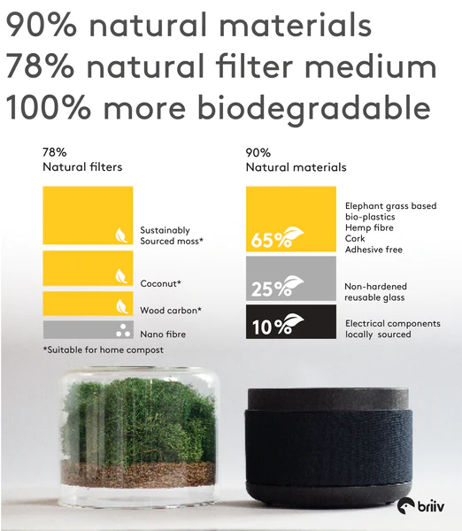
Energy Efficiency and Sustainability
Energy-saving Modes
Smart purifiers feature energy-efficient modes to minimize power consumption while maintaining optimal air quality.
Environmentally Friendly Materials
Many smart purifiers are designed using sustainable materials and are built for longevity, reducing environmental impact.
Filter Recycling Programs
Manufacturers offer filter recycling programs, promoting responsible disposal and reducing environmental footprint.

Slide 17
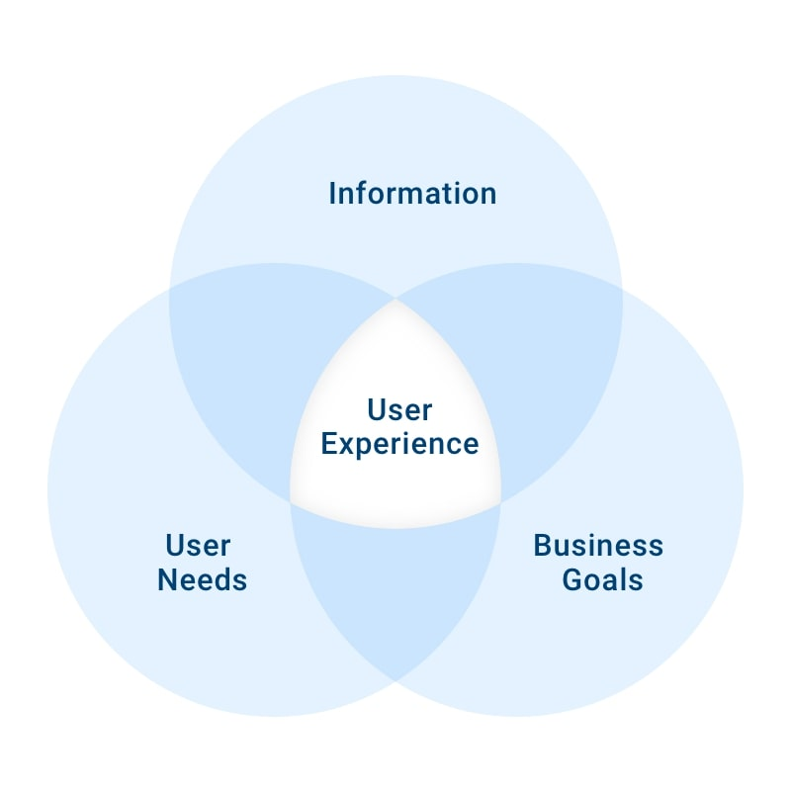
User-Centric Design
Compact Form Factor
Smart purifiers are designed to be sleek and compact, seamlessly blending into various living spaces.
Customizable Settings
Users can personalize purification settings based on their preferences and specific air quality needs.
Low Noise Operation
These purifiers operate quietly, ensuring minimal disruption to daily activities and providing a peaceful indoor environment.

Slide 18
Section 3
Market Opportunities and Consumer Trends

Slide 19


Market Growth and Trends
Rapid Market Expansion
The smart air purifier market is experiencing significant growth due to increasing health awareness and technological advancements.
Consumer Priorities
Consumers are prioritizing air purification solutions that offer smart features, energy efficiency, and effective air cleaning.
Innovation and Differentiation
Manufacturers are focusing on innovation to differentiate their products and cater to evolving consumer needs.

Slide 20

Consumer Adoption and Behaviour
Smart Home Integration
The trend of smart home adoption is driving the integration of smart air purifiers into connected home ecosystems.
Health-Conscious Consumers
Health-conscious individuals are actively seeking air purification solutions that align with their wellness goals.
Online Reviews and Recommendations
Consumers heavily rely on online reviews and recommendations to make informed purchase decisions, emphasizing the importance of positive user experiences.

Slide 21

Case Study: Consumer Satisfaction and Loyalty
User Experience
A case study involving residential users demonstrated high satisfaction with the performance and smart features of the air purifiers.
Brand Loyalty
Positive experiences with smart air purifiers led to increased brand loyalty and recommendations within the users' social circles.
Word-of-Mouth Marketing
Satisfied consumers became brand advocates, contributing to organic growth through positive word-of-mouth marketing.

Slide 22
Section 4
Brand Positioning and Marketing Strategy

Slide 23
Click here to visit our website 👇
UrbanAir

Slide 24

Brand Identity and Values
Commitment to Health and Wellness
The brand is positioned as a champion of indoor air quality, emphasizing the importance of clean and healthy living spaces.
Innovation and Technology
Emphasizing the brand's commitment to technological advancement and smart solutions for air purification.
Customer-Centric Approach
Prioritizing customer satisfaction, user experience, and continuous improvement based on consumer feedback.

Slide 25

Target Audience Segmentation
Health Enthusiasts
Targeting individuals who prioritize health and wellness, seeking advanced air purification solutions for their homes.
Tech-Savvy Consumers
Appealing to consumers who value smart home integration, connectivity, and user-friendly technology.
Eco-Conscious Individuals
Engaging with environmentally conscious consumers who seek sustainable and energy-efficient home appliances.

Slide 26

Multi-Channel Marketing Approach
Digital Marketing
Leveraging social media, online advertising, and influencer partnerships to reach tech-savvy and health-conscious audiences.
In-Store Promotions
Collaborating with retail partners to showcase the product's features and benefits through in-store displays and demonstrations.
Educational Campaigns
Conducting workshops, webinars, and educational content to raise awareness about indoor air quality and the benefits of smart air purifiers.

Slide 27

Thank You

